Slide 1



Mobile Application Penetration Testing
Mohamed Rashed AL marri
X / Twitter : @xcode0x

Slide 2
| Table Of Contents
Introduction in Mobile Apps .
Static analysis .
App Encryption & App Dumping
How think out of the box.
Some useful recourses and My Advises

Slide 3

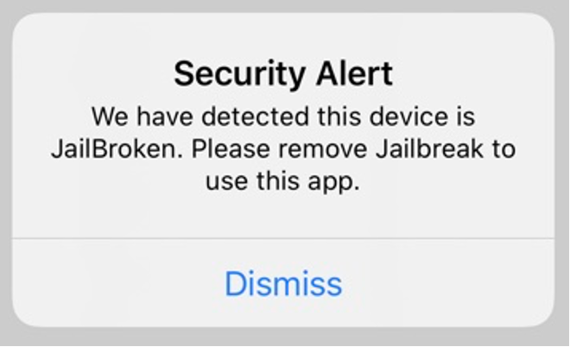

| What is Mobile app and How it Work ?
A mobile application or app is a program or software application designed to run on a mobile device .
Screen
Code
OS / Data

Slide 4
| Types of Mobile Applications .
Native App
Hybrid App
Cross Platform Apps

Slide 5

| Native App
Android :
IOS :
Java
kotlin
Swift
objective-c

Slide 6
| Hybrid App
jQuery Mobile
Cordova Apache

Slide 7
| Cross Platform Apps
Flutter - Dart
Xamarin - (C#)

Slide 8

| Jailbreaking
unc0ver
checkra1n
Odyssey
Dopamine
Bootstrap
Ref : https://ios.cfw.guide/get-started/

Slide 9
| Types of Jailbreak
- Semi-Tethered
Semi-Untethered
Ref : https://ios.cfw.guide/types-of-jailbreak/#untethered-jailbreaks

Slide 10
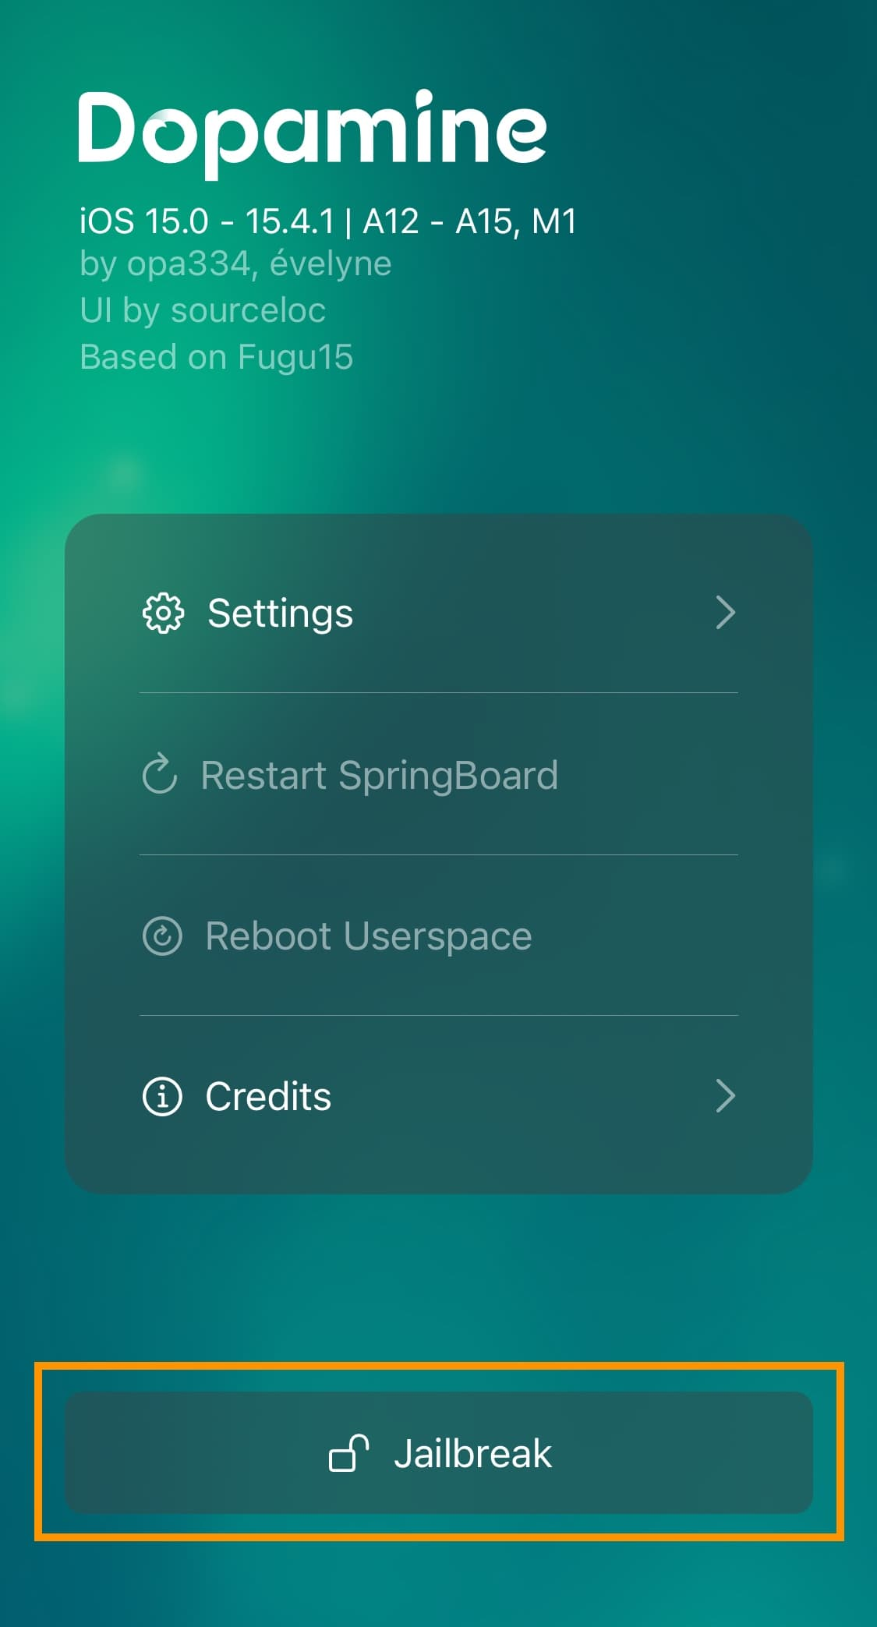
| Semi-Untethered

Slide 11
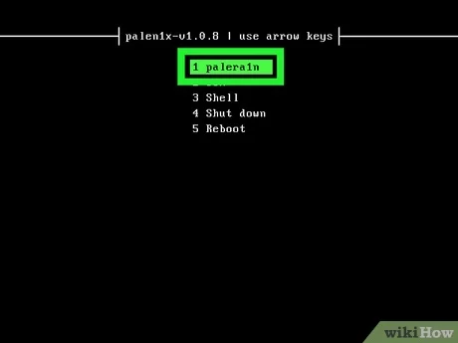
| Semi-Tethered Jailbreak

Slide 12
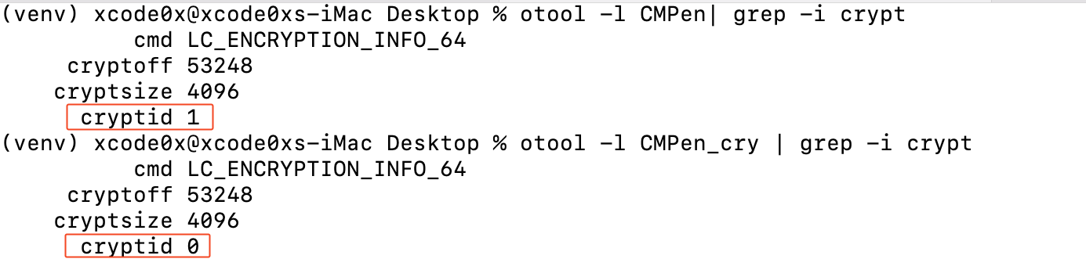
| App Encryption
Ref : eMAPT Course - INE

Slide 13
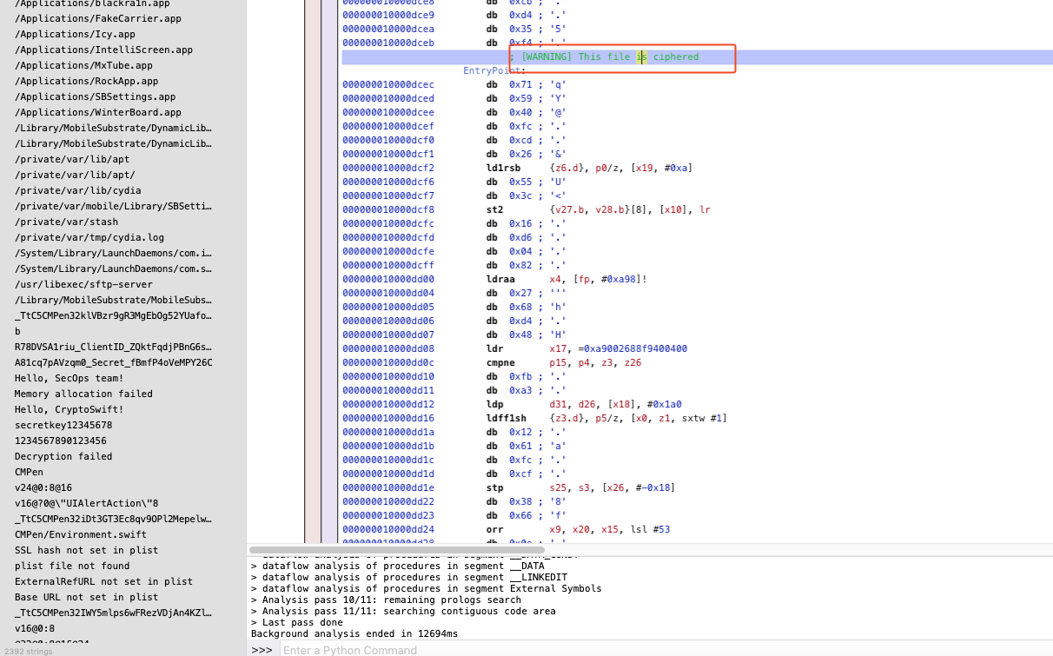
| Encryption Binary

Slide 14
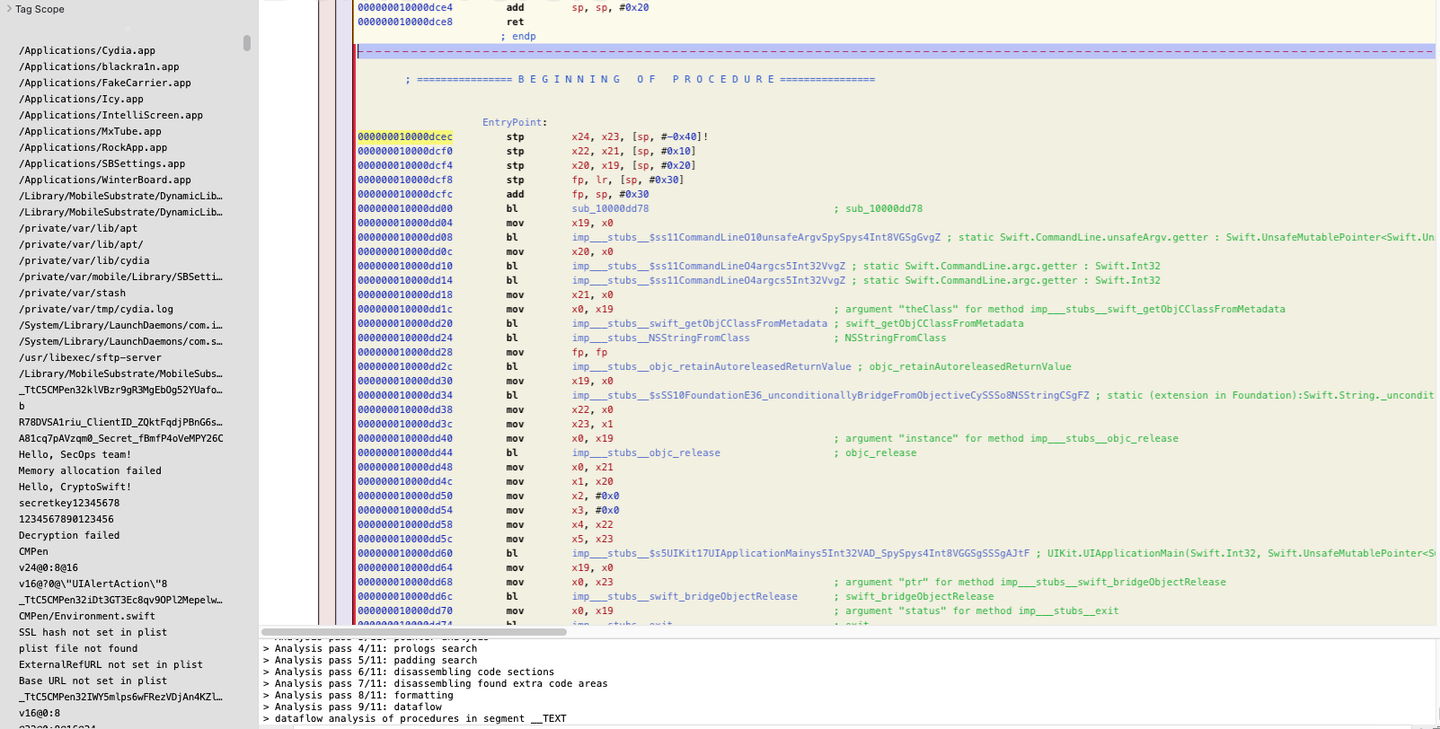
| Decryption Binary

Slide 15

| Dumping iOS apps
iGameGod
https://igamegod.app/repo/

Slide 16
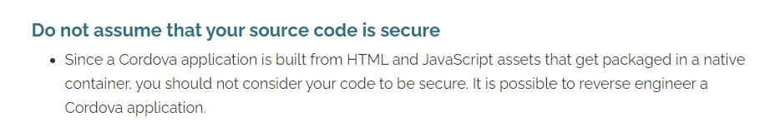
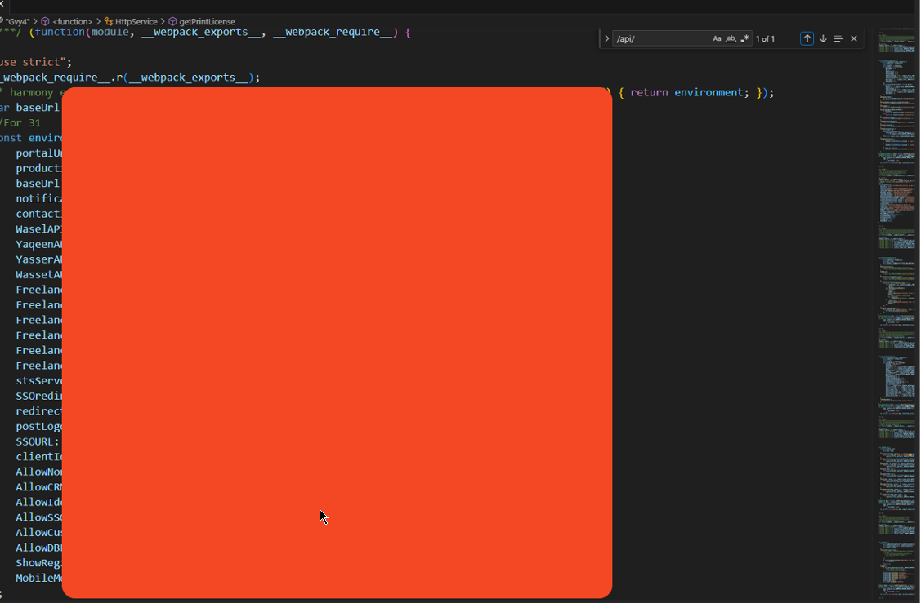
| Cordova Apache Issue
Ref : Here

Slide 17
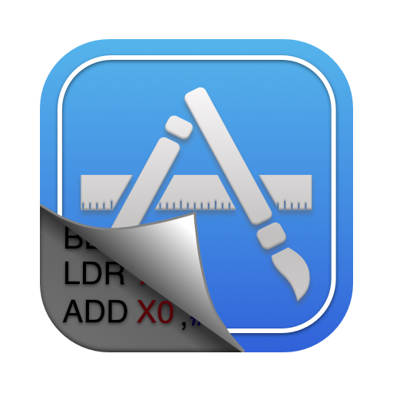

| Static analysis
https://www.hopperapp.com/
https://hex-rays.com/ida-pro/
https://ghidra-sre.org/

Slide 18


| Static analysis
https://mobsf.github.io/docs/#/
https://github.com/xcodeOn1/ipa-scope

Slide 19
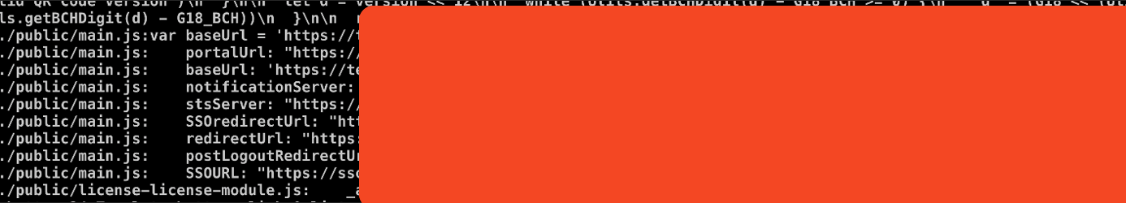
| Static analysis
grep & Regex

Slide 20
| Demo

Slide 21
| Resources
https://developer.apple.com/documentation/xcode/writing-arm64-code-for-apple-platforms#//apple_ref/doc/uid/TP40009020-SW1
https://developer.arm.com/documentation/
https://x.com/xcode0x/status/1765598807327150389
https://x.com/xcode0x/status/1752189141910167729

